Slide 1
A Fixed-Parameter Tractable Algorithm for Matrix Domination
Information Processing Letters 90 (2004) 267–272
Mark Weston
Department of Computer Science, University of Victoria, P.O. Box 3055, Victoria, BC, Canada
Received 5 December 2001
Communicated by F. Dehne
Presenter: Mao-Yuan Kao
Date: Mar. 31, 2006

Slide 2
Abstract
MATRIX DOMINATION is the NP-complete problem of determining
whether a given {0,1} matrix contains a set of k non-zero entries that are in the
same row or same column as all other non-zero entries. Using a kernelization
and search tree approach, we show the problem to be fixed-parameter tractable
with running time O(n³ + 1.959^{k}k^{5/2}).

Slide 3
Fixed-Parameter Tractable(FPT)
A parameterized problem with problem size n and parameter k is defined to
be fixed-parameter tractable (FPT) if
it can be solved in time f (k)n ^{c} or f (k) + n ^{c}, where c is a constant independent
of both n and k and f () is an arbitrary function.
Thus the classical exponential complexity explosion which we see for NP-
complete problems can often be confined to
the a parameter k in the function f ().
Typically, FPT problems result in small and manageable functions for f (),
often in the range 2^{k}, and c is typically small as well.

Slide 4
Vertex Cover
K=2 k=3
It yields a simple FPT algorithm of running time O(2^{k}n)

Slide 5
Matrix Domination
Input: An n × m matrix M with entries from {0, 1}, and a positive integer k.
Parameter: k.
Question: Is there a set of k or fewer non-zero entries in M that dominate all
others?
Note that M does not have to be a square matrix.

Slide 6
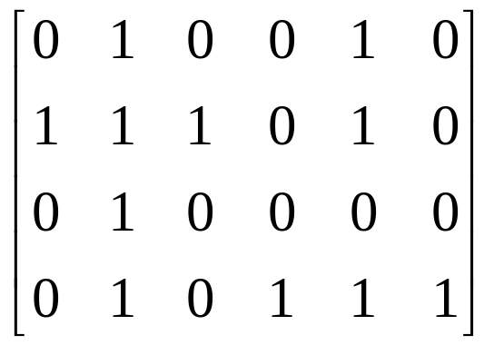
Matrix Domination
two circled non-zero items dominate all other non-zero items

Slide 7
Kernelization and Algorithm
We now introduce the method of creating a kernel, by reducing the problem
instance I to an equivalent instance I’ , where the size of I’ is bounded by a
function of the parameter k.
This is a polynomial time parametric transformation of MATRIX
DOMINATION to itself.
Recall that the initial matrix M is bounded in size by n with k as the parameter.
The algorithm on the input matrix M proceeds as follows:

Slide 8
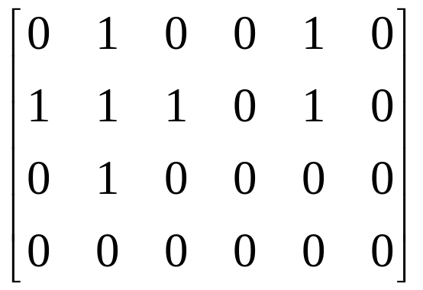
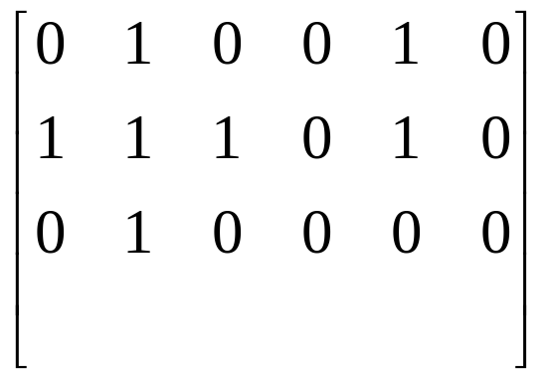
Step 1
For all rows r and columns c in M, if r or c is “empty” it can be deleted from M to produce a matrix M’.
Complexity:O(n²)

Slide 9
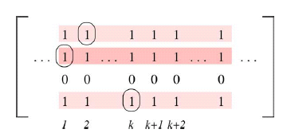
Step 2
For all columns c (or similarly rows r), if there are at least k+2 identical copies of c the columns can be reduced to k + 1 identical copies of c.
Complexity:O(n³)

Slide 10
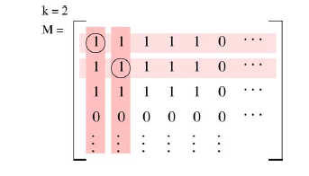
Step 2.1
greater than k copies of a column (or row) with greater than k non-zero entries
  No-instance

Slide 11
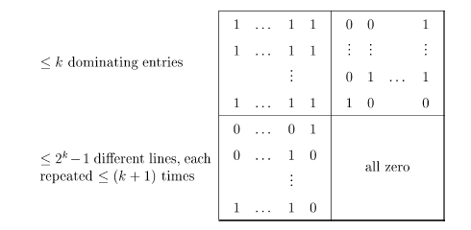
Problem Kernel
the size of the matrix is now bounded by a function of k. To see this, consider
that if the matrix has a solution the rows and columns can be rearranged so that
the at most k dominating non-zero entries are in the top left corner of the
matrix . Then the bottom right corner of the matrix must be zero (as otherwise
the k entries would not dominate them). Thus after the reduction there can be
at most 2^{k} −1 unique rows (as all-zero rows have been removed)
(similarly for columns), each of which can be repeated at most k+1 times
(2^{k}-1) ×(k+1) ∈ O(2^{k} k)

Slide 12
Step 3
we use an algorithm for the following problem of
CONSTRAINT BIPARTITE VERTEX COVER:
Input: An undirected bipartite graph G = (V1,V2,E) and two
integers k1 and k2.
Question: Do there exist two subsets of vertices C1 ⊆
V1 and C2 ⊆ V2 with |C1|≦ k1 and |C2| ≦ k2 such that each edge
in E has at least one of its endpoints in C1 ∪ C2?

Slide 13
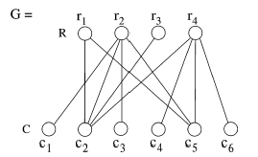
Step 3
Matrix ->bipartite graph
Complexity:n+n² -> O(n²)

Slide 14
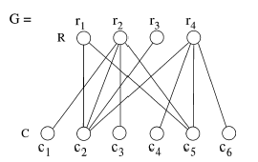
Step 4
Using a search tree, we find all vertex covers of size at most 2 for the input. This step is explored in detail in [6].
  size 2 ^{2k}=4^{k}
using kernelization techniques based on vertex degree of the nodes. Briefly, a node v with degree(v) at least k must be included in
the vertex cover
  Size 1.399^{2k}=1.959 ^{k}

Slide 15
Step 5
We now have a set S = {G: G is a vertex cover with at most k vertices in each
of the two edge sets R, C}.
The graphs in S have at most 2k vertices and at most k² edges.
The problem is now one instance of EDGE COVER restricted to bipartite graphs:
Input: A bipartite graph G = (V1,V2,E), and an integer k
where |V1|≦ k and |V2| ≦ k.
Parameter: k.
Question: Is there a set of edges E’ ⊆ E with |E’| ≦ k such that for all v in (V1
∪ V2) there is an edge e ∈ E’ such that v is incident to e?
Informally, can we find up to k edges in G that connect to all of the vertices in
G?

Slide 16
Edge Cover
K=4
V₁
V₁
V₂
V₂
V₁
V₁
V₂
V₂

Slide 17
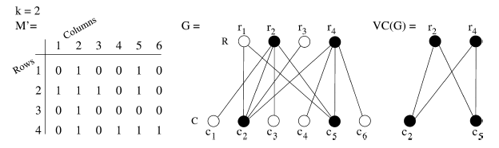
Step 5
The problem is now one instance of EDGE COVER restricted to bipartite graphs:
Complexity:O(K^{5/2})

Slide 18
Step 5.1
To find the maximum bipartite matching in a graph
if no matching exists, the problem is immediately a no-instance and we can answer no.

Slide 19
|v₁|=x, |v₂|=y, x≦ y≦ k
V₁
用x個邊
剩:最多k-x
V₂

Slide 20
if the problem is a yes-instance, we have found a maximum matching between
the x nodes of V1 and any x nodes of V2, using x edges.
Then we have used at most k−x edges to connect the remaining nodes in V2 to
nodes in V1. Thus we have used at most k − x + x = k edges to connect every
node in V1 to a node in V2.
Complexity: O(n³+1.959^{k}k^{5/2})

